Slide 1
Introduction to Computer Science (371-1-1601)
Lectures by: Dr. Dan Vilenchik & Dr. Zion Siksik
Recitations by: Ariel Cohen, Moshiko Davidian, Assaf Livne, Yair Mazal

Slide 2
Sorting 10b
Todays topics:
Bubble sort
Merge sort
Quick sort

Slide 3
Sorting
Why so many sorting methods? Why aren’t we just using the “best” one?
Every sorting method has its best- and worst-case scenario, we should keep that in mind when choosing a method.
Every method is special, and we like them the way they are.

Slide 4
Bubble sort
The main idea of this method is that the larger numbers “rise” to the “top” (end) of the list.
The steps are:
N = 0
Compare pair of numbers, if larger is to the left swap between them.
Move to next couple.
Continue until reaching the end - N
N+=1, go back to step 2 until N = length – 1 of list

Slide 5
Bubble sort
3
5
2
4
First iteration:
3
5
2
4
3
5
2
4
3
2
5
4
3
2
5
4
3
2
4
5
3
2
4
5

Slide 6
Bubble sort
Second iteration:
3
2
4
5
2
3
4
5
2
3
4
5
2
3
4
5
Third iteration:
2
3
4
5
2
3
4
5
2
3
4
5

Slide 7
Bubble sort - code
def bubble_sort(lst): for k in range(len(lst)): for i in range(len(lst) - 1 - k): if lst[i] > lst[i+1]: lst[i+1], lst[i] = lst[i], lst[i+1] return lst

Slide 8
Bubble sort
What is the complexity?
What is the best case?
What is the worst case?

Slide 9

Bubble sort
Best case: $𝒪(n)$
Worst case: $𝒪(n^{2})$
Average case: $𝒪(n^{2})$

Slide 10
Merge sort
Divide the unsorted list into two sub-lists. Repeat until reaching lists of single elements.
merge pairs of sub-lists until all is merged.

Slide 11
Merge sort - example
3
5
2
4
1
6
8
3
Division:
3
5
2
4
1
6
8
3
3
5
2
4
1
6
8
3
3
5
2
4
1
6
8
3

Slide 12
Merge sort - example
3
5
2
4
1
6
8
3
Merging:
3
5
2
4
1
6
3
8
3
5
2
4
1
6
3
8
2
1

Slide 13
Merge sort - example
3
5
2
4
1
6
3
8
2
3
1
3

Slide 14
Merge sort - example
3
5
2
4
1
6
3
8
2
3
4
1
3
6

Slide 15
Merge sort - example
3
5
2
4
1
6
3
8
2
3
4
5
1
3
6
8

Slide 16
Merge sort - example
2
3
4
5
1
3
6
8
1
5
2
4
1
6
8
3

Slide 17
Merge sort - example
2
3
4
5
1
3
6
8
1
2
2
4
1
6
8
3

Slide 18
Merge sort - example
2
3
4
5
1
3
6
8
1
2
3
4
1
6
8
3

Slide 19
Merge sort - example
2
3
4
5
1
3
6
8
1
2
3
3
1
6
8
3

Slide 20
Merge sort - example
2
3
4
5
1
3
6
8
1
2
3
3
4
6
8
3

Slide 21
Merge sort - example
2
3
4
5
1
3
6
8
1
2
3
3
4
5
8
3

Slide 22
Merge sort - example
2
3
4
5
1
3
6
8
1
2
3
3
4
5
6
3

Slide 23
Merge sort - example
2
3
4
5
1
3
6
8
1
2
3
3
4
5
6
8

Slide 24
Merge sort - code
def merge_sort(lst): if len(lst) == 1: return lst left_lst = merge_sort(lst[:math.ceil(len(lst)/2)]) right_lst = merge_sort(lst[math.ceil(len(lst)/2):]) l = 0 m = 0 res_lst = [] while(len(res_lst) < (len(left_lst) + len(right_lst)) ): if l < len(left_lst) and m < len(right_lst): if left_lst[l] <= right_lst[m]: res_lst.append(left_lst[l]) l += 1 else: res_lst.append(right_lst[m]) m += 1 elif l < len(left_lst): res_lst.append(left_lst[l]) l += 1 else: res_lst.append(right_lst[m]) m += 1 return res_lst

Slide 25
Merge sort
What is the complexity?
What is the best case?
What is the worst case?

Slide 26

Merge sort
Best case: $𝒪(n\log{n})$
Worst case: $𝒪(n\log{n})$
Average case: $𝒪(n\log{n})$

Slide 27
Quick sort
Choose a pivot
Sort the list to two unsorted sub-lists, smaller and larger than the pivot
Repeat 1-2 for sub-lists.
Merge all sub-lists.
There are many ways to choose the pivot and to sort the list which can significantly effect the performance.

Slide 28
Quick sort - example
3
6
1
4
2
5
Choose pivot (we will use last number):
3
6
1
4
2
5

Slide 29
Quick sort - example
3
6
1
4
2
5
Sort to two sub-lists:
3
6
1
4
2
5

Slide 30
Quick sort - example
3
6
1
4
2
5
Sort to two sub-lists:
3
1
4
2
6
5

Slide 31
Quick sort - example
3
6
1
4
2
5
Sort to two sub-lists:
3
1
4
2
6
5

Slide 32
Quick sort - example
3
6
1
4
2
5
Sort to two sub-lists:
3
1
4
2
6
5

Slide 33
Quick sort - example
3
6
1
4
2
5
Sort to two sub-lists:
3
1
4
2
6
5

Slide 34
Quick sort - example
3
1
4
2
6
5
Move pivot and sort sub-lists:
3
1
4
2
5
6
3
1
4
2
6
A list of one element is sorted

Slide 35
Quick sort - example
Choose pivot and continue to sort:
3
1
4
2
1
4
3
2

Slide 36
Quick sort - example
3
1
4
2
1
4
3
2

Slide 37
Quick sort - example
3
1
4
2
1
4
3
2

Slide 38
Quick sort - example
1
3
4
2
Insert pivot between:
1
2
4
3
1
4
3

Slide 39
Quick sort - example
4
3
4
3
3
4

Slide 40
Quick sort - example
Last step, merge all sub-lists:
1
2
3
4
5
6
1
2
3
4
5
6

Slide 41
Quick sort - code
def quick_sort(lst): if len(lst) <= 1: return lst # use last number as pivot pivot = lst[-1] left_lst = [] right_lst = [] for i in range(len(lst)-1): if lst[i] < pivot: left_lst.append(lst[i]) else: right_lst.append(lst[i]) return quick_sort(left_lst) + [pivot] + quick_sort(right_lst)

Slide 42
Quick sort
What is the complexity?
What is the best case?
What is the worst case?

Slide 43

Quick sort
Best case: $𝒪(n\log{n})$
Worst case: $𝒪(n^{2})$
Average case: $𝒪(n\log{n})$

Slide 44
General tips and comparison
When the data is already sorted, we will prefer to use bubble over quick sort, due to the “best case” results.
Merge sort requires a lot of additional memory which is not always available
Randomly choosing the pivot in quick sort can help us when handling sorted lists
Think about the data that your algorithm will sort (is it sorted or not? will all the data be available at once? Do I have additional information about the data?)

Slide 45
Sorting exercise
Sort a binary array containing: ’0’, ‘1’
Do it in linear complexity with a constant memory complexity

Slide 46
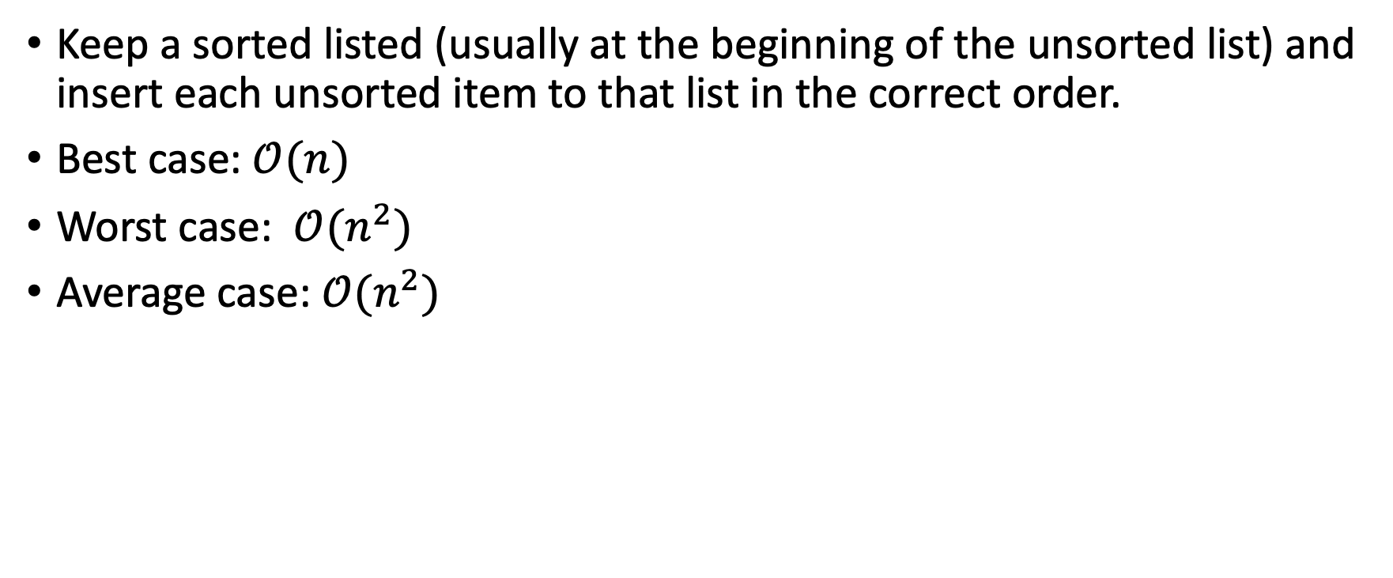
Insertion sort
Keep a sorted listed (usually at the beginning of the unsorted list) and insert each unsorted item to that list in the correct order.
Best case: $𝒪(n)$
Worst case: $𝒪(n^{2})$
Average case: $𝒪(n^{2})$

